Slide 1

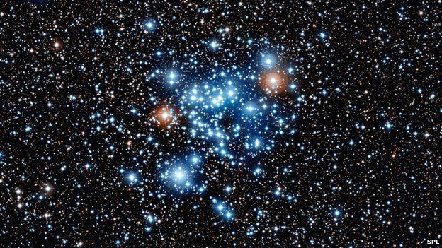
Star Age Prediction
By: Omnia Elmensahwy
Artificial Intelligence Engineering Student

Slide 2
Agenda:
Intro to stars
Problem Statement
Differences between the two data sets
EDA
Data Visualization
Physics behind the newly formed dataset.
Modelling
Business wise insights
Resources

Slide 3
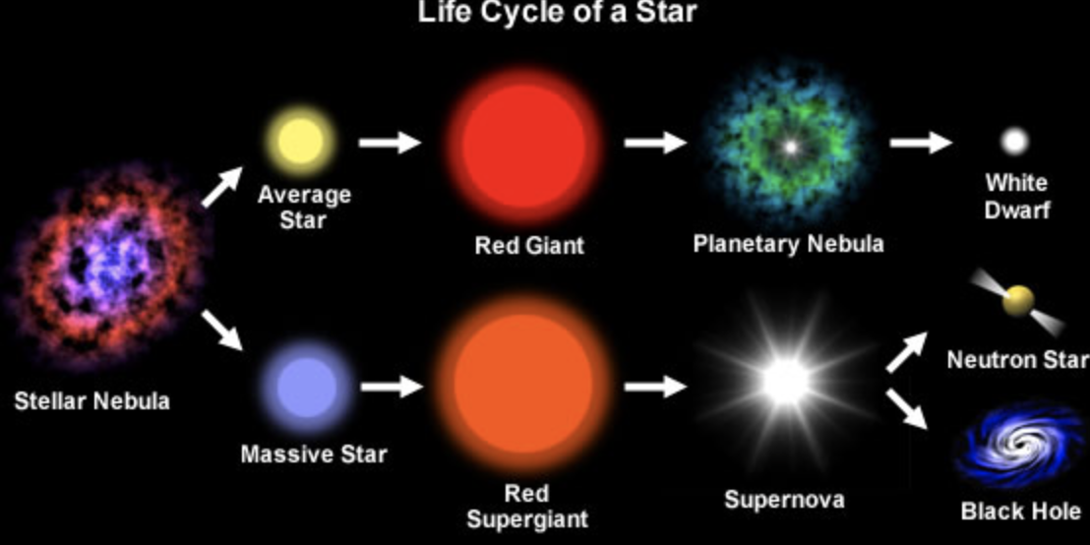
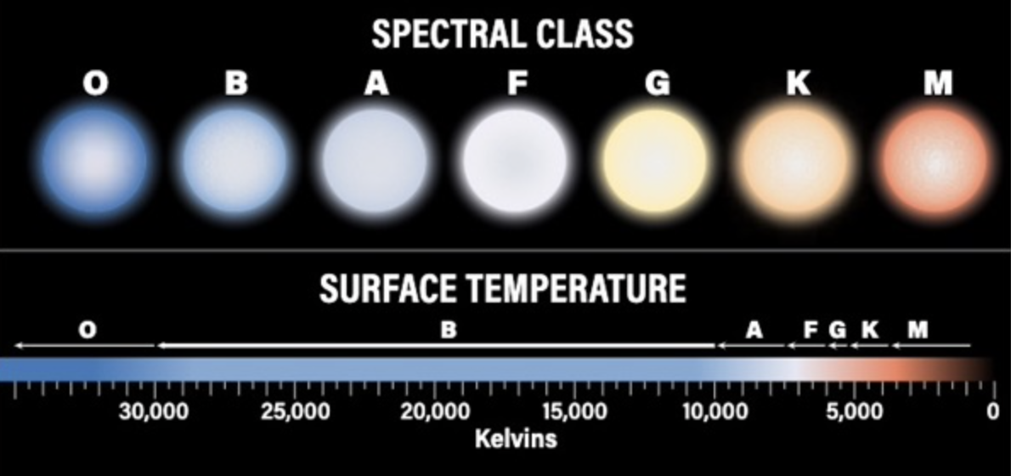
Intro to Stars:
The Star type That we are Interested in:
Spectral Class as the first goal of the dataset:
The star gets larger, redder, and more luminous as it expands and cools.

Slide 4
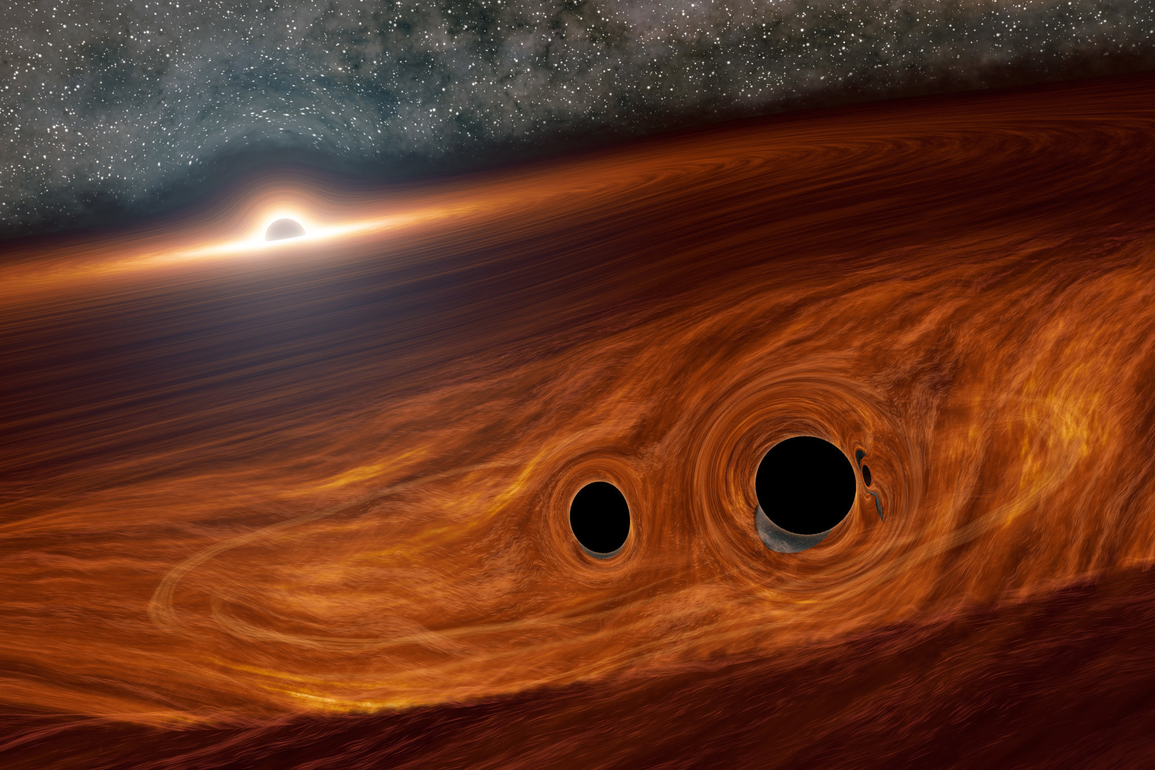
Problem statement
Although Star Type Classification is extremely important, However I will only use it to predict another star features not as the target from the dataset. The goal which I aimed to predict is the approximate Star Age as it is particularly relevant to the search for signs of life outside our solar system.

Slide 5
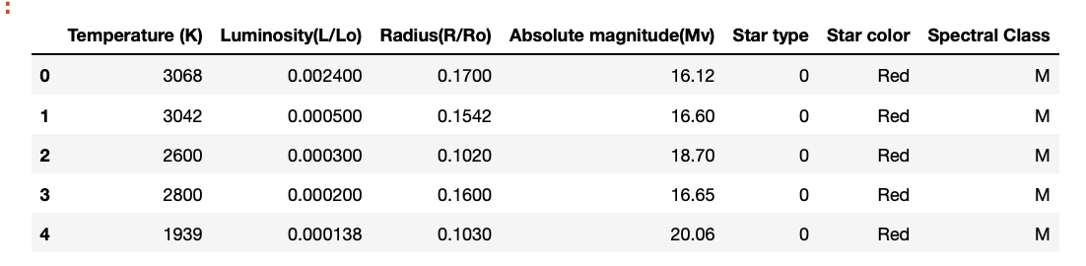
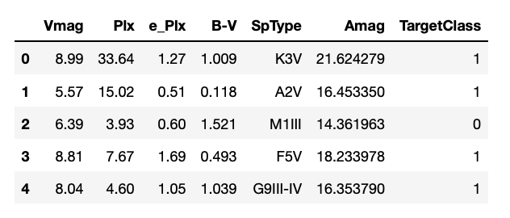
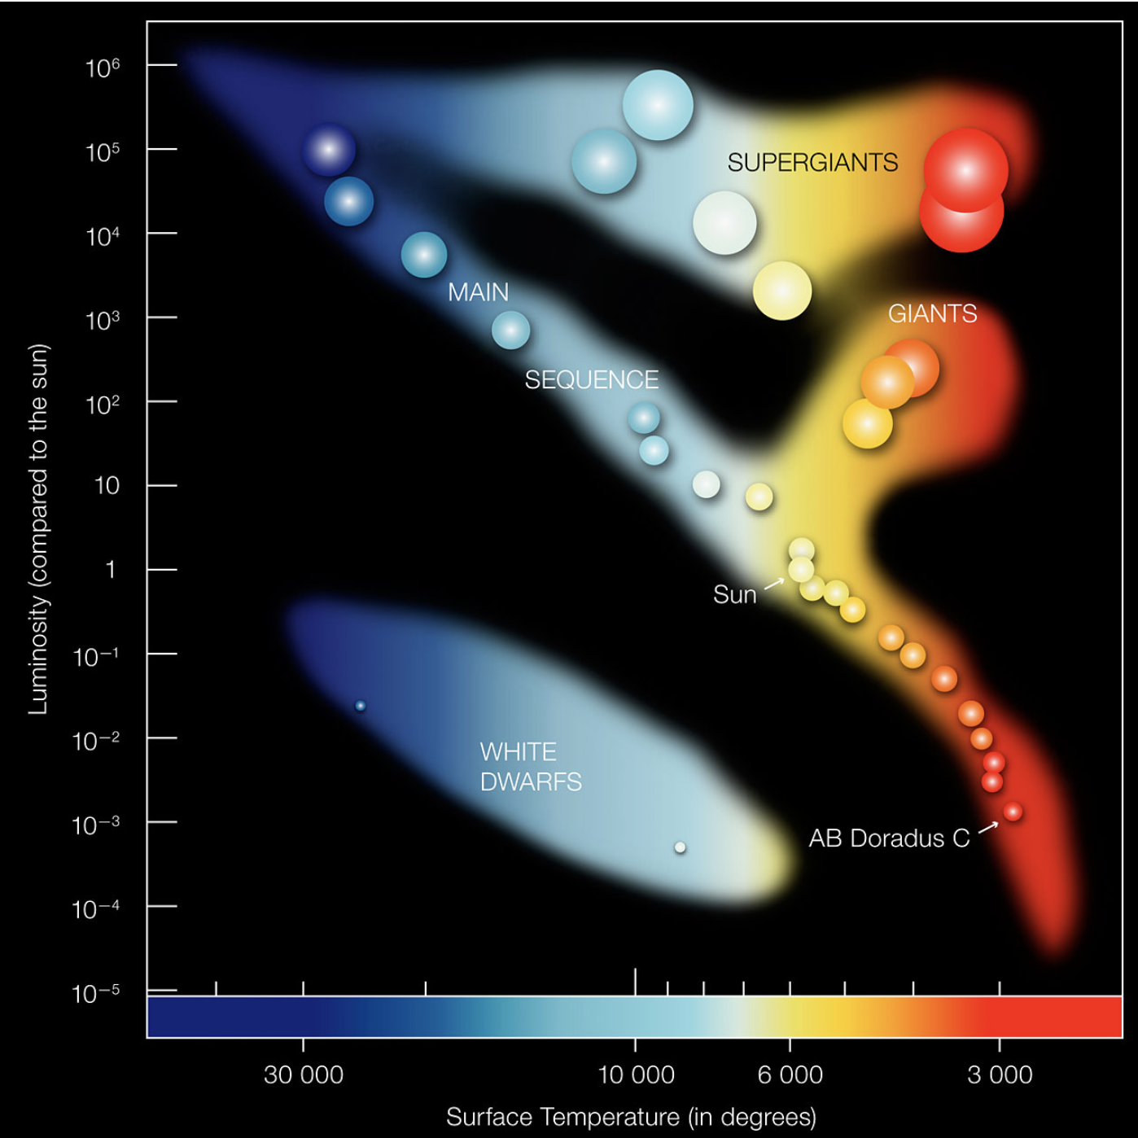
Differences between the two data sets
Small dataset features:
Targeted dataset features:
Hertzsprung-Russell Diagram:

Slide 6
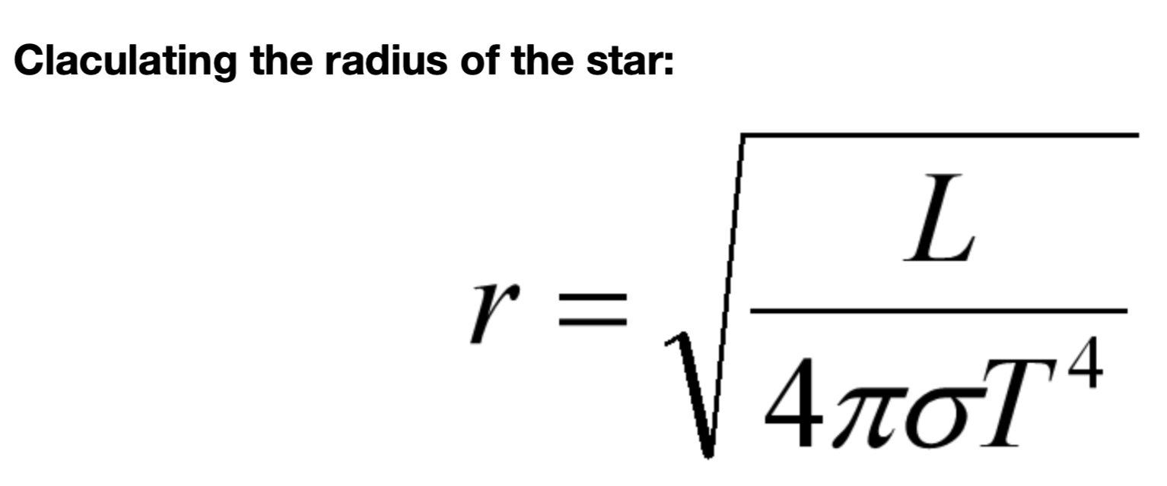
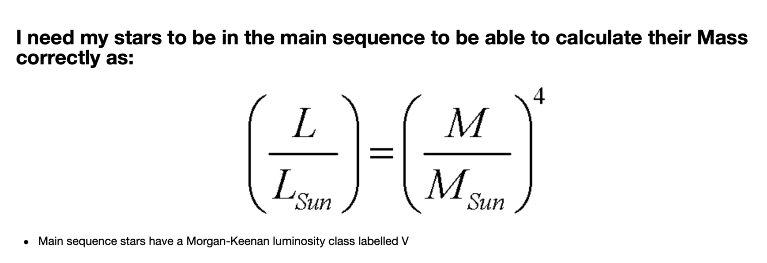
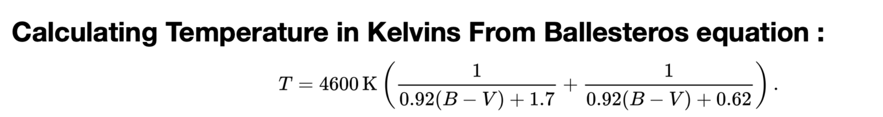
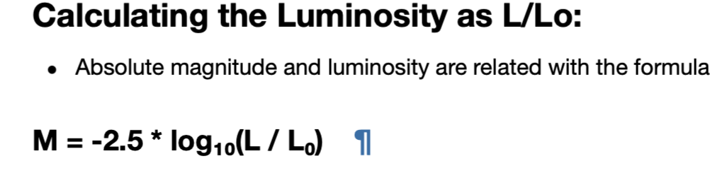
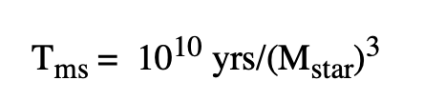
Physics Behind the New features:
Needed features are:
Temperature in Kelvins
Luminosity as L/Lo
Radius
Main Sequence Stars
Star Mass
Star Lifetime as Our target Feature
Star Life Time Equation:

Slide 7
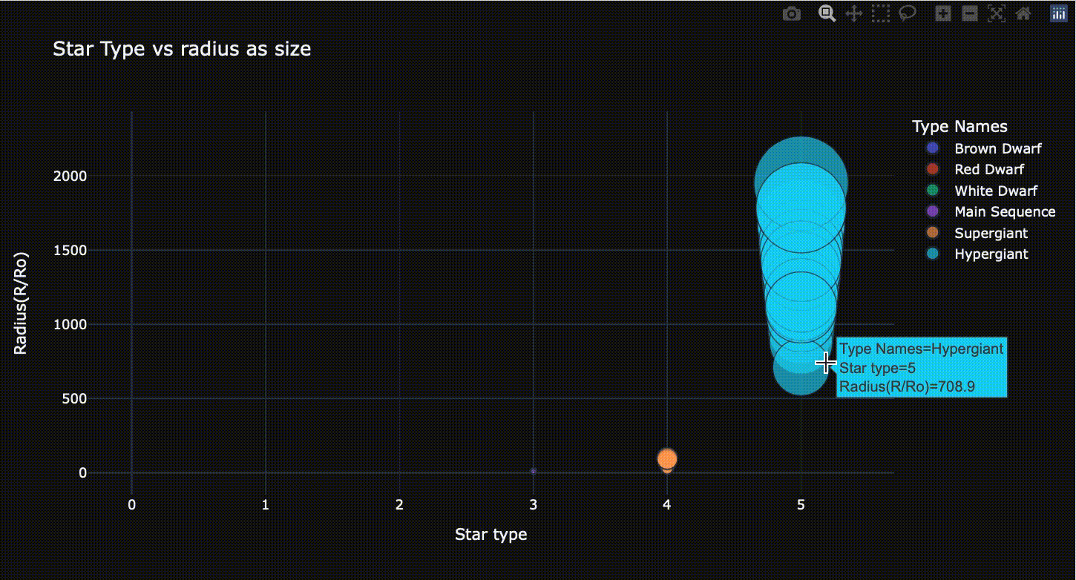
Visualization for the small dataset:

Slide 8
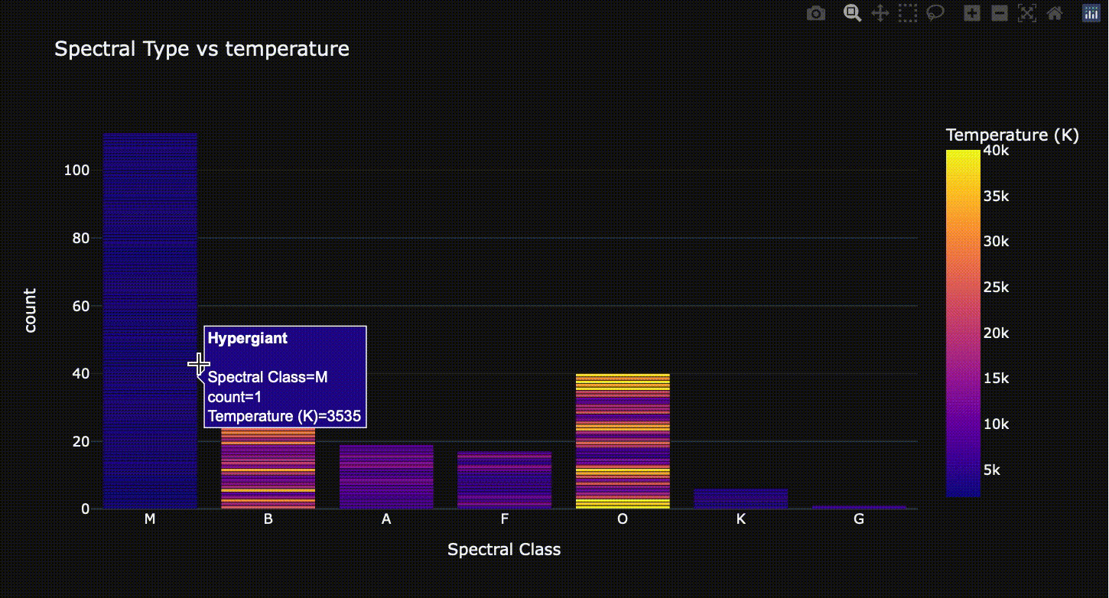
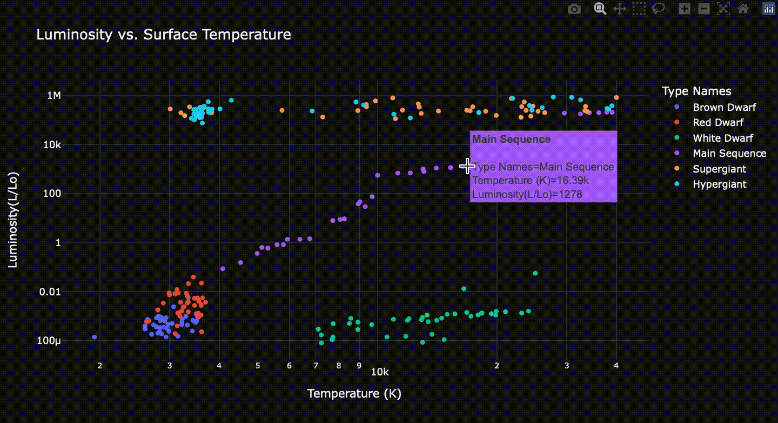
The data is distributed simillar to the HR diagram, so we need the same features in the new data to determine the location of each star in the HR diagram.

Slide 9
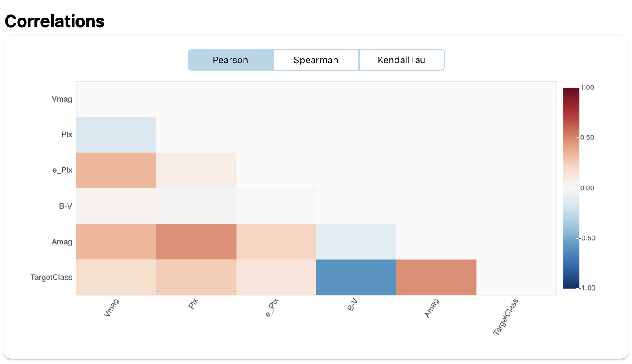
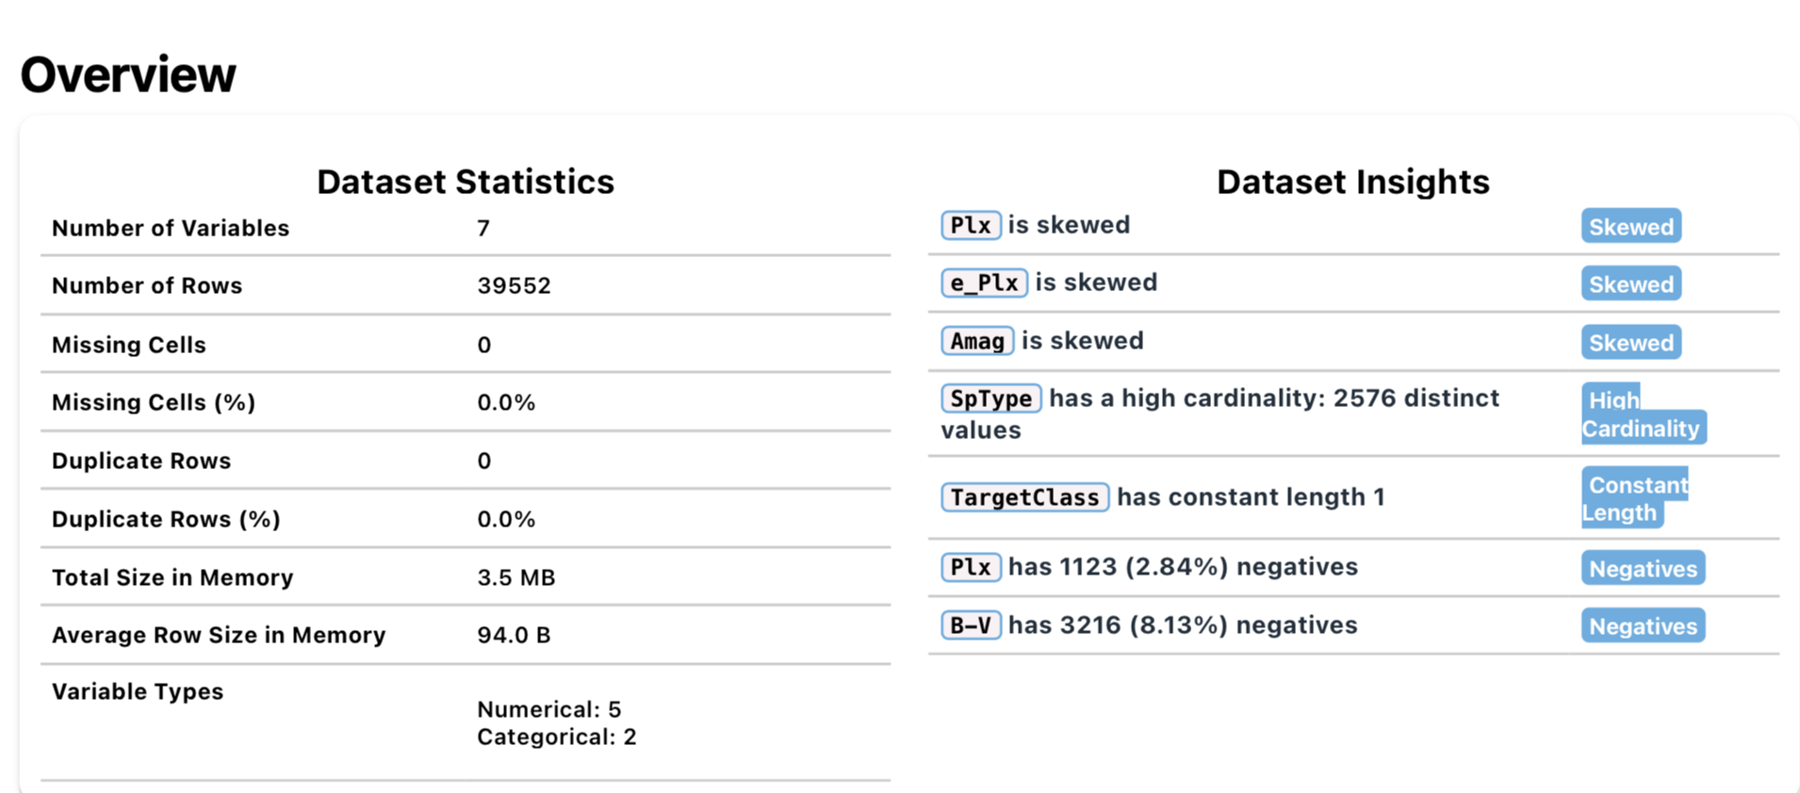
EDA and Visualization For the targeted Dataset:

Slide 10
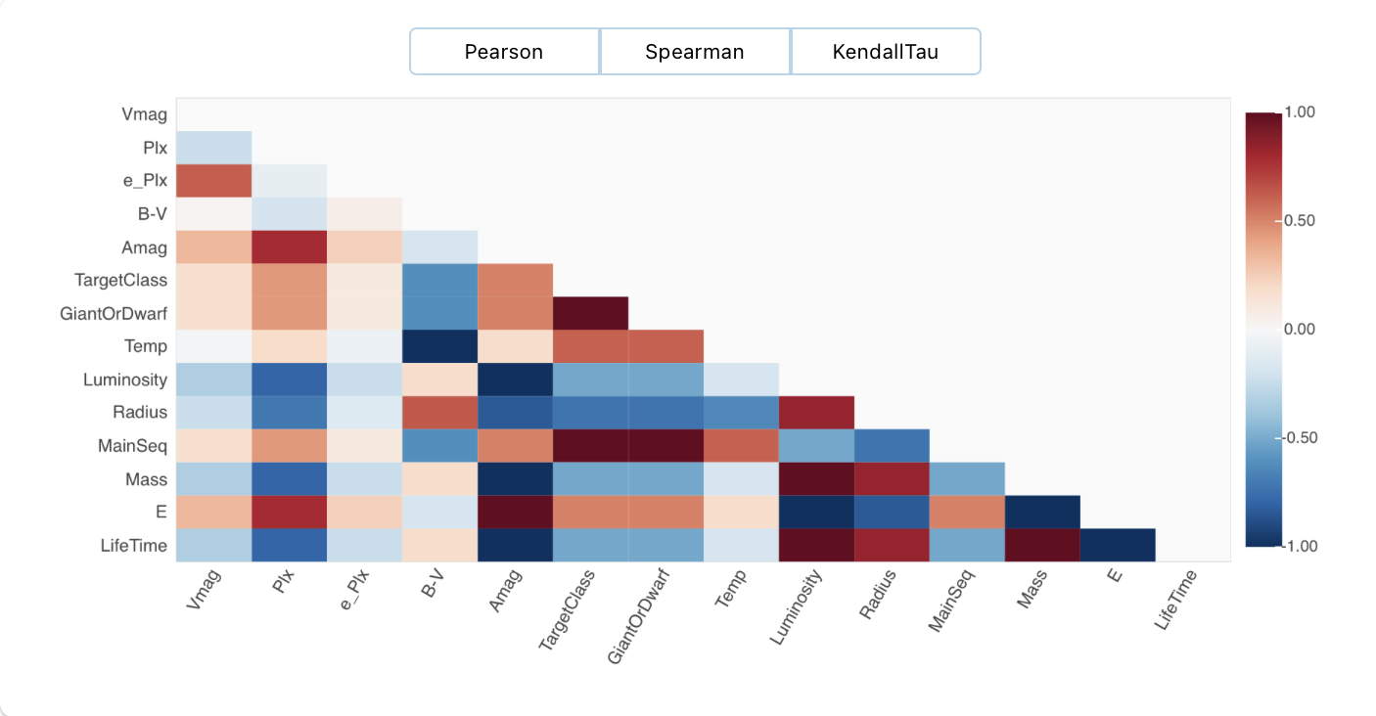
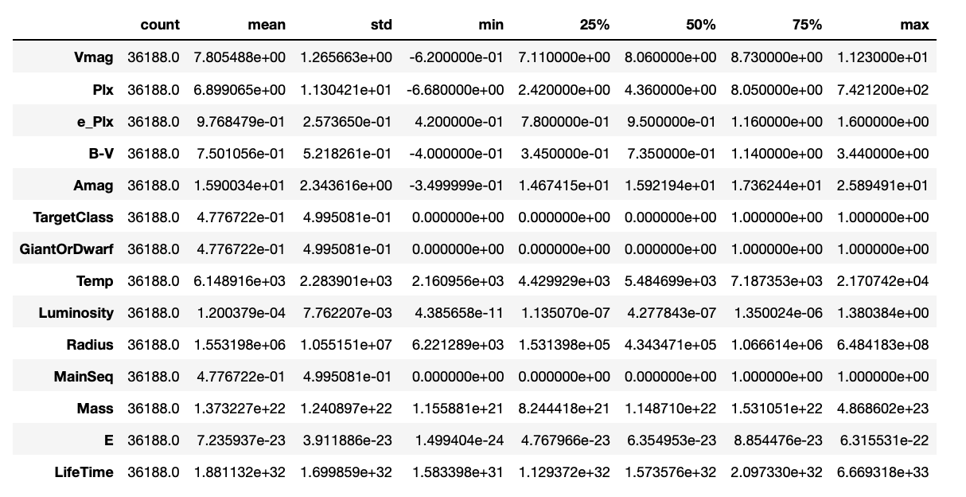
Stars Approximate Age:

Slide 11
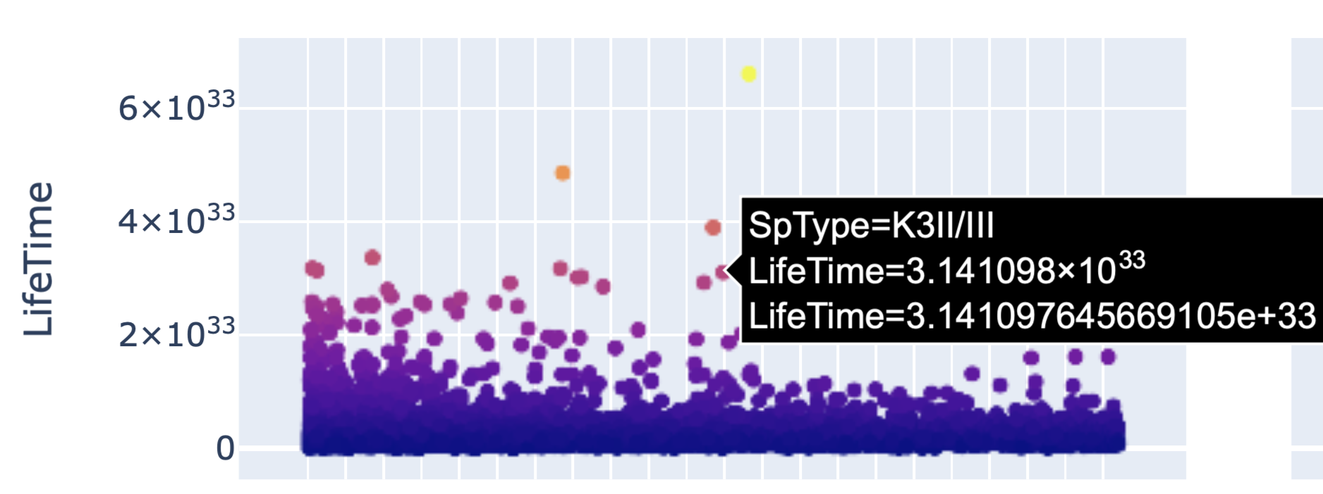
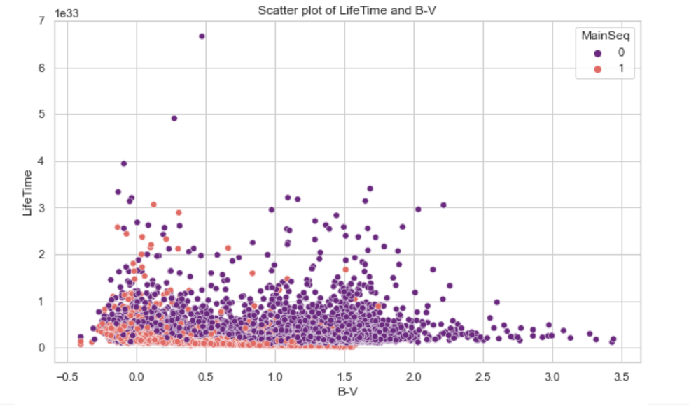
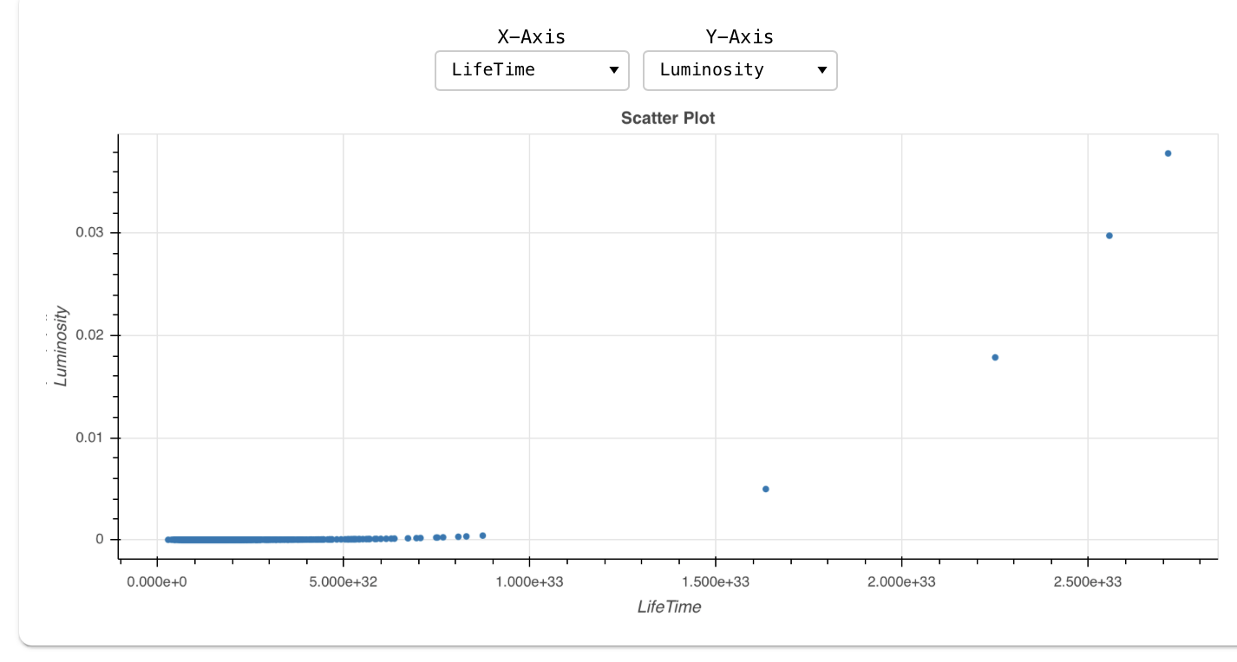
Star Age Visualization:

Slide 12
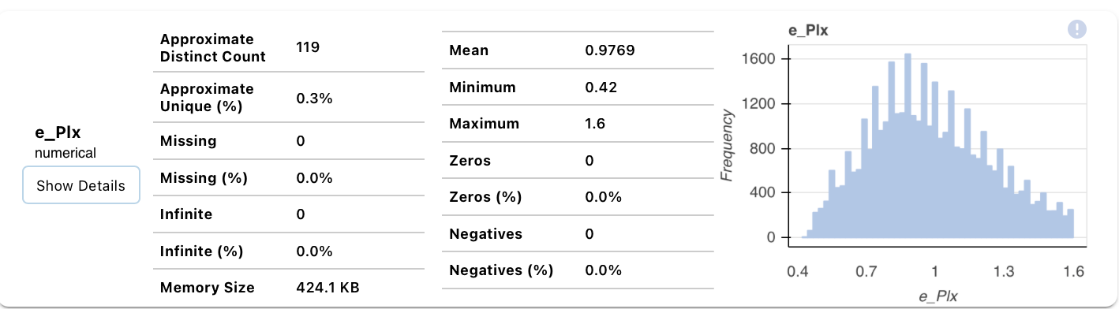
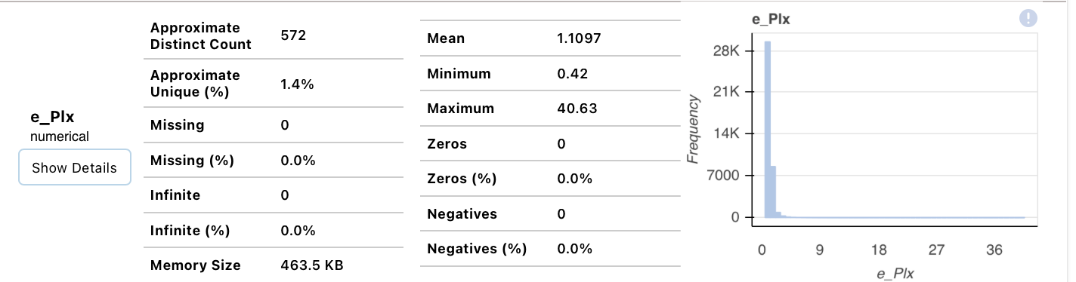
Pre-Processing:
1)Reducing the PLX Error:
2) Using Standard Scaller to re Scale the data

Slide 13
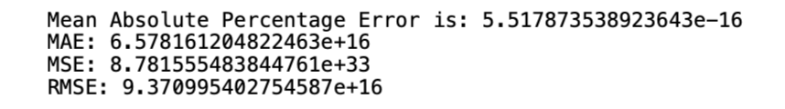
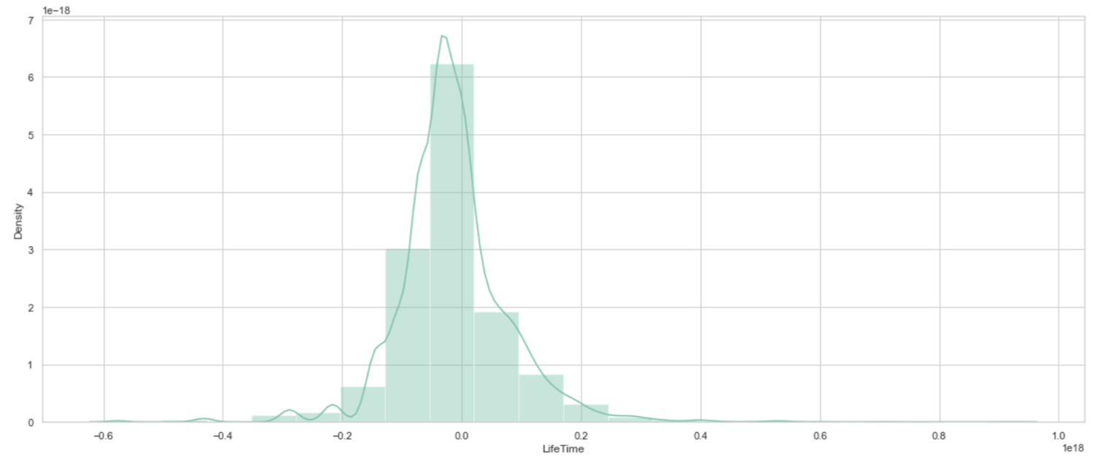
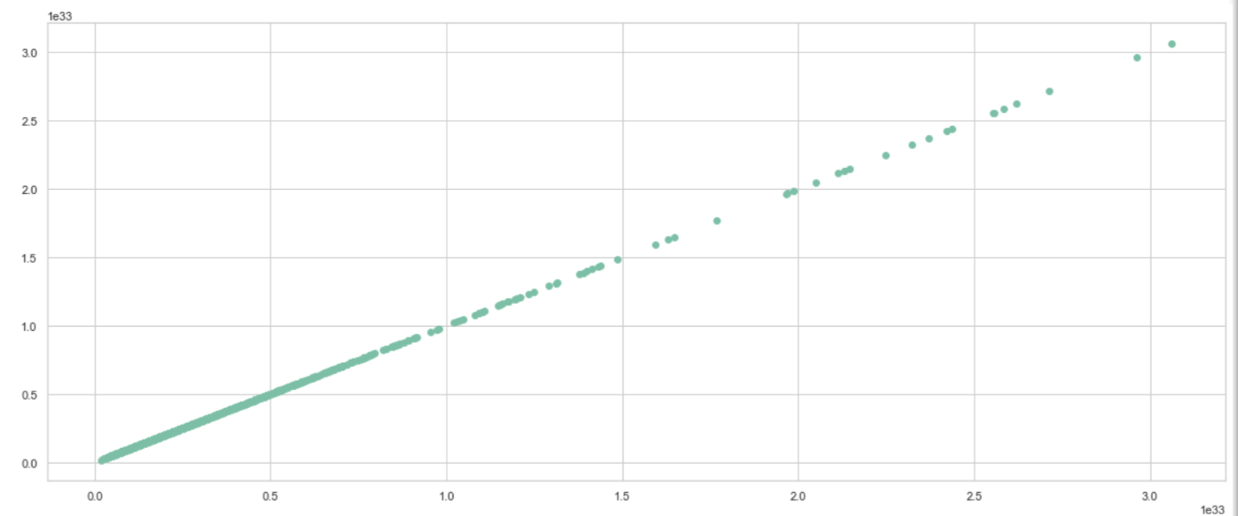
Applying Machine Learning Algorithms:
1- Linear Regression:

Slide 14
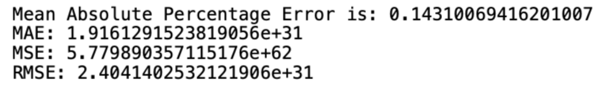
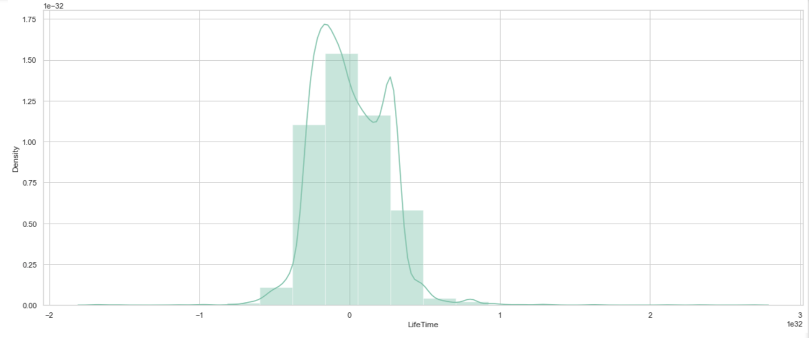
Applying Machine Learning Algorithms:
2- Random Forest:

Slide 15
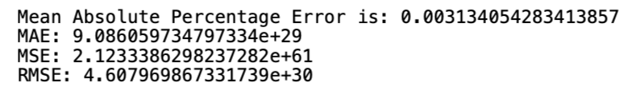
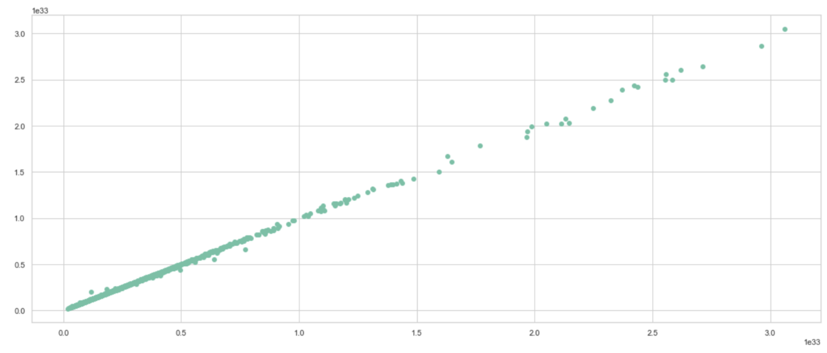
Applying Machine Learning Algorithms:
3- K Nearest Neighbors Classifier:

Slide 16
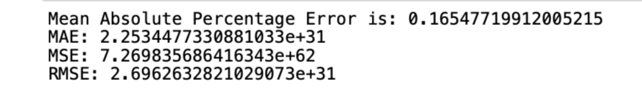
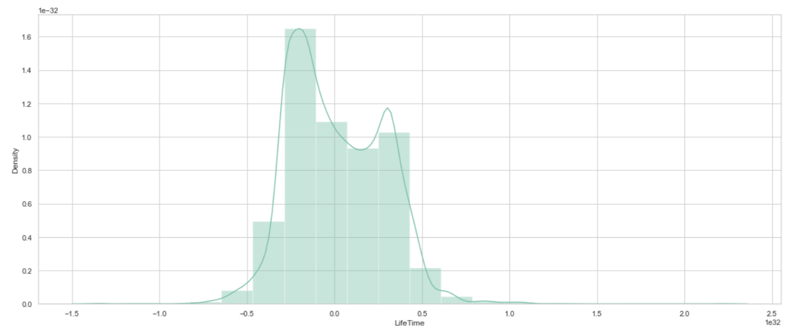
Applying Machine Learning Algorithms:
4-Ada Boost Regressor

Slide 17
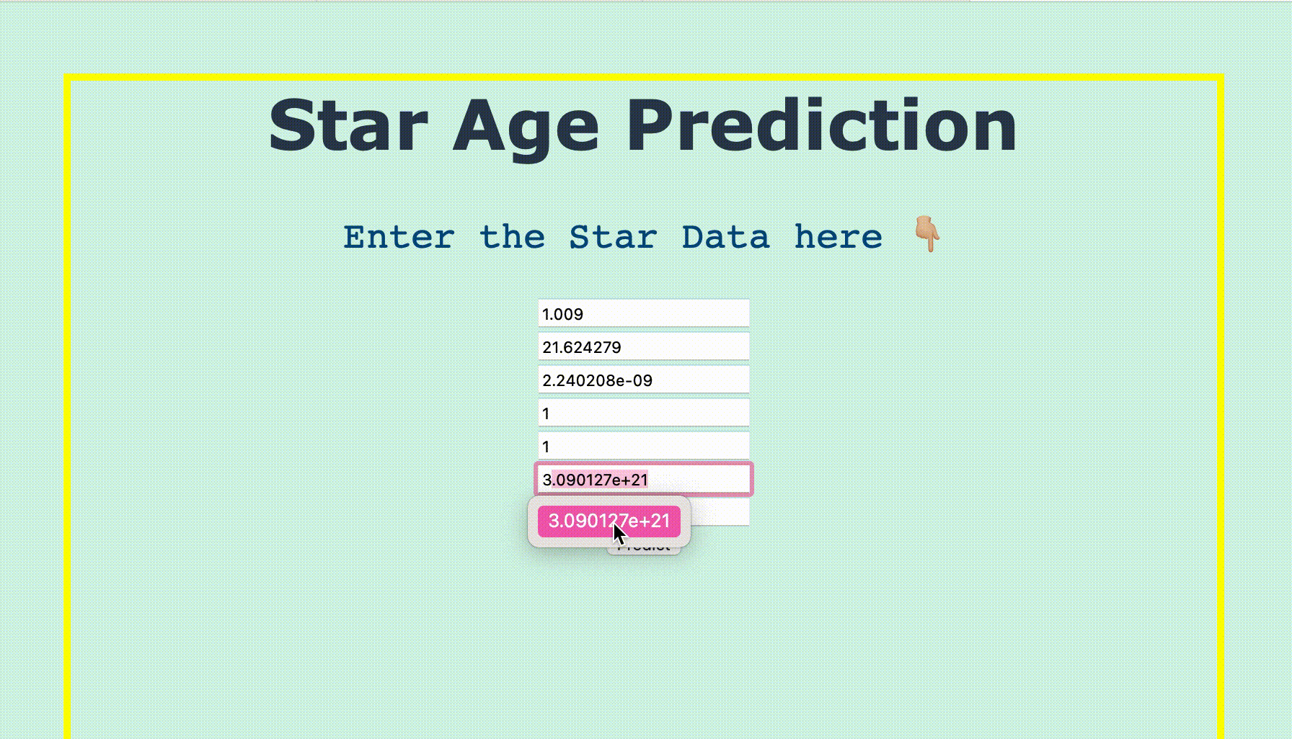
Choosing the Best Model Based on the Best MAPE Score:
KNN is the best model and the one that will be deployed in my API

Slide 18
Business wise insights:
This data can be used for real universal predictions considering the PlX unit conversion and fixing the error.
The Life Time Age of the Star is highly correlated with the Tempreature, Luminosity and and the Color of the star, thus, the more lum the older the star.
There is no Possible Black Hole formation from any of the stars as none of the stars mass is bigger than the SUN mass.

Slide 19
Resources
Coursera Astronomy Data Driven Course From The University of Sydney:
https://www.coursera.org/learn/data-driven-astronomy/home/welcome
Hertzsprung-Russell Diagram :
https://astronomy.swin.edu.au/cosmos/h/hertzsprung-russell+diagram
Star Mass:
https://www.researchgate.net/figure/Mass-radius-relation-for-Kepler-red-giants-with-RGB-stars-in-blue-and-clump-stars-in_fig6_257882348
Black Hole properties:
https://public.nrao.edu/ask/properties-of-stars-which-result-in-black-holes/
https://public.nrao.edu/ask/what-is-the-critical-mass-at-which-a-star-becomes-a-black-hole/
PRINCIPLES OF STELLAR STRUCTURE (OHIO State University):
http://www.astronomy.ohio-state.edu/~dhw/Intro/lec6.html
http://www.astronomy.ohio-state.edu/~pogge/Ast162/Unit2/structure.html
Blackbody Radiation and Quantization of Energy fot Luminosity and B-V:
https://web.njit.edu/~gary/321/Lecture2.html
Finding Temperature and Spectral Type Based on Ballesteros equation:
http://astro.physics.uiowa.edu/ITU/labs/professional-labs/photometry-of-a-globular/part-2-finding-temperature.html
Calculating the Radius of a Star:
https://cas.sdss.org/dr4/en/proj/advanced/hr/radius1.asp
Brightest Stars: Luminosity & Magnitude:
https://www.space.com/21640-star-luminosity-and-magnitude.html
Distance Parallax equation:
http://astronomyonline.org/Science/Parallax.asp
Finding Our Sun From Amag:
https://arxiv.org/abs/1804.07788

Slide 20
Thanks

